Slide 1
Digital Portfolio
STUDENT NAME:Kanimozhi D
REGISTER NO AND NMID: 35824U09051
DEPARTMENT: BCA
COLLEGE: COLLEGE/ UNIVERSITY Don bosco college (Co-Ed )
Yelagiri hills Thiruvalluvar university.

Slide 2
PROJECT TITLE Smart portofolio website

Slide 3


AGENDA
Problem Statement
Project Overview
End Users
Tools and Technologies
Portfolio design and Layout
Features and Functionality
Results and Screenshots
Conclusion
Github Link
3/21/2024 Annual Review

Slide 4

PROBLEM STATEMENT In todays competitive world professionals and students need a digital prrsence to showcase their skills project and achievements. Traditional resumes are static and do not provide interactive or engaging information. Hence there is a need for a smart portofolio website that represents an individuals profile dynamically and attractively.

Slide 5

PROJECT OVERVIEW The smart portofolio website is a personal branding platform desingned to highlight an individuals skills education projects certifications and achievements. It provides an interactive user interface responsiveness across devices and easy navigation.

Slide 6

WHO ARE THE END USERS? Students and job seekers Freelancers and enterprenerus Professionals wanting to showcase their expertise Recruiters or hiring managers reviewing applicants.

Slide 7

TOOLS AND TECHNIQUES Frontend:HTML5,CSS3,JavaScript, Bootstrap /Twilwind CSS Backend:Node. Js/PHP Database:MySQL/MongoDB Version control :Git&GitHub Deployment :GitHub pages /Netlify/vercel

Slide 8
POTFOLIO DESIGN AND LAYOUT
Home page: introduction with name, tagline and profile image
About section :personal information, education, background
Skill section :Technical and soft skills with progress bars/ icons
Project section :Display of completed projects with description and links
Certification Section :showcase of achievements
8

Slide 9
FEATURES AND FUNCTIONALITY Responsive design Smooth navigation with animation Interactive projrct gallery with GitHub demo links Contact form integration with email service Dark light mode toggle Downloadable resume option

Slide 10
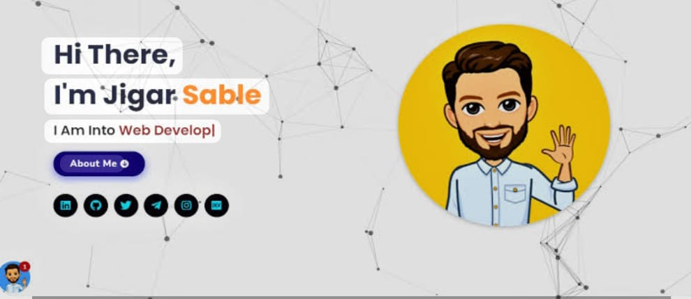

RESULTS AND SCREENSHOTS Website successfully deployed online Tested across multiple devices and browsers Screenshot showing homepage, skills, projects, and contact page
3/21/2024 Annual Review
10

Slide 11
CONCLUSION The smart portofolio website provides a dynamic, professional, and engaging platform for individuals to present themselves digitally. It enhances career opportunities creates a personal brand and allows recruiters to explore a candidates work efficiently.
11

